Slide 1

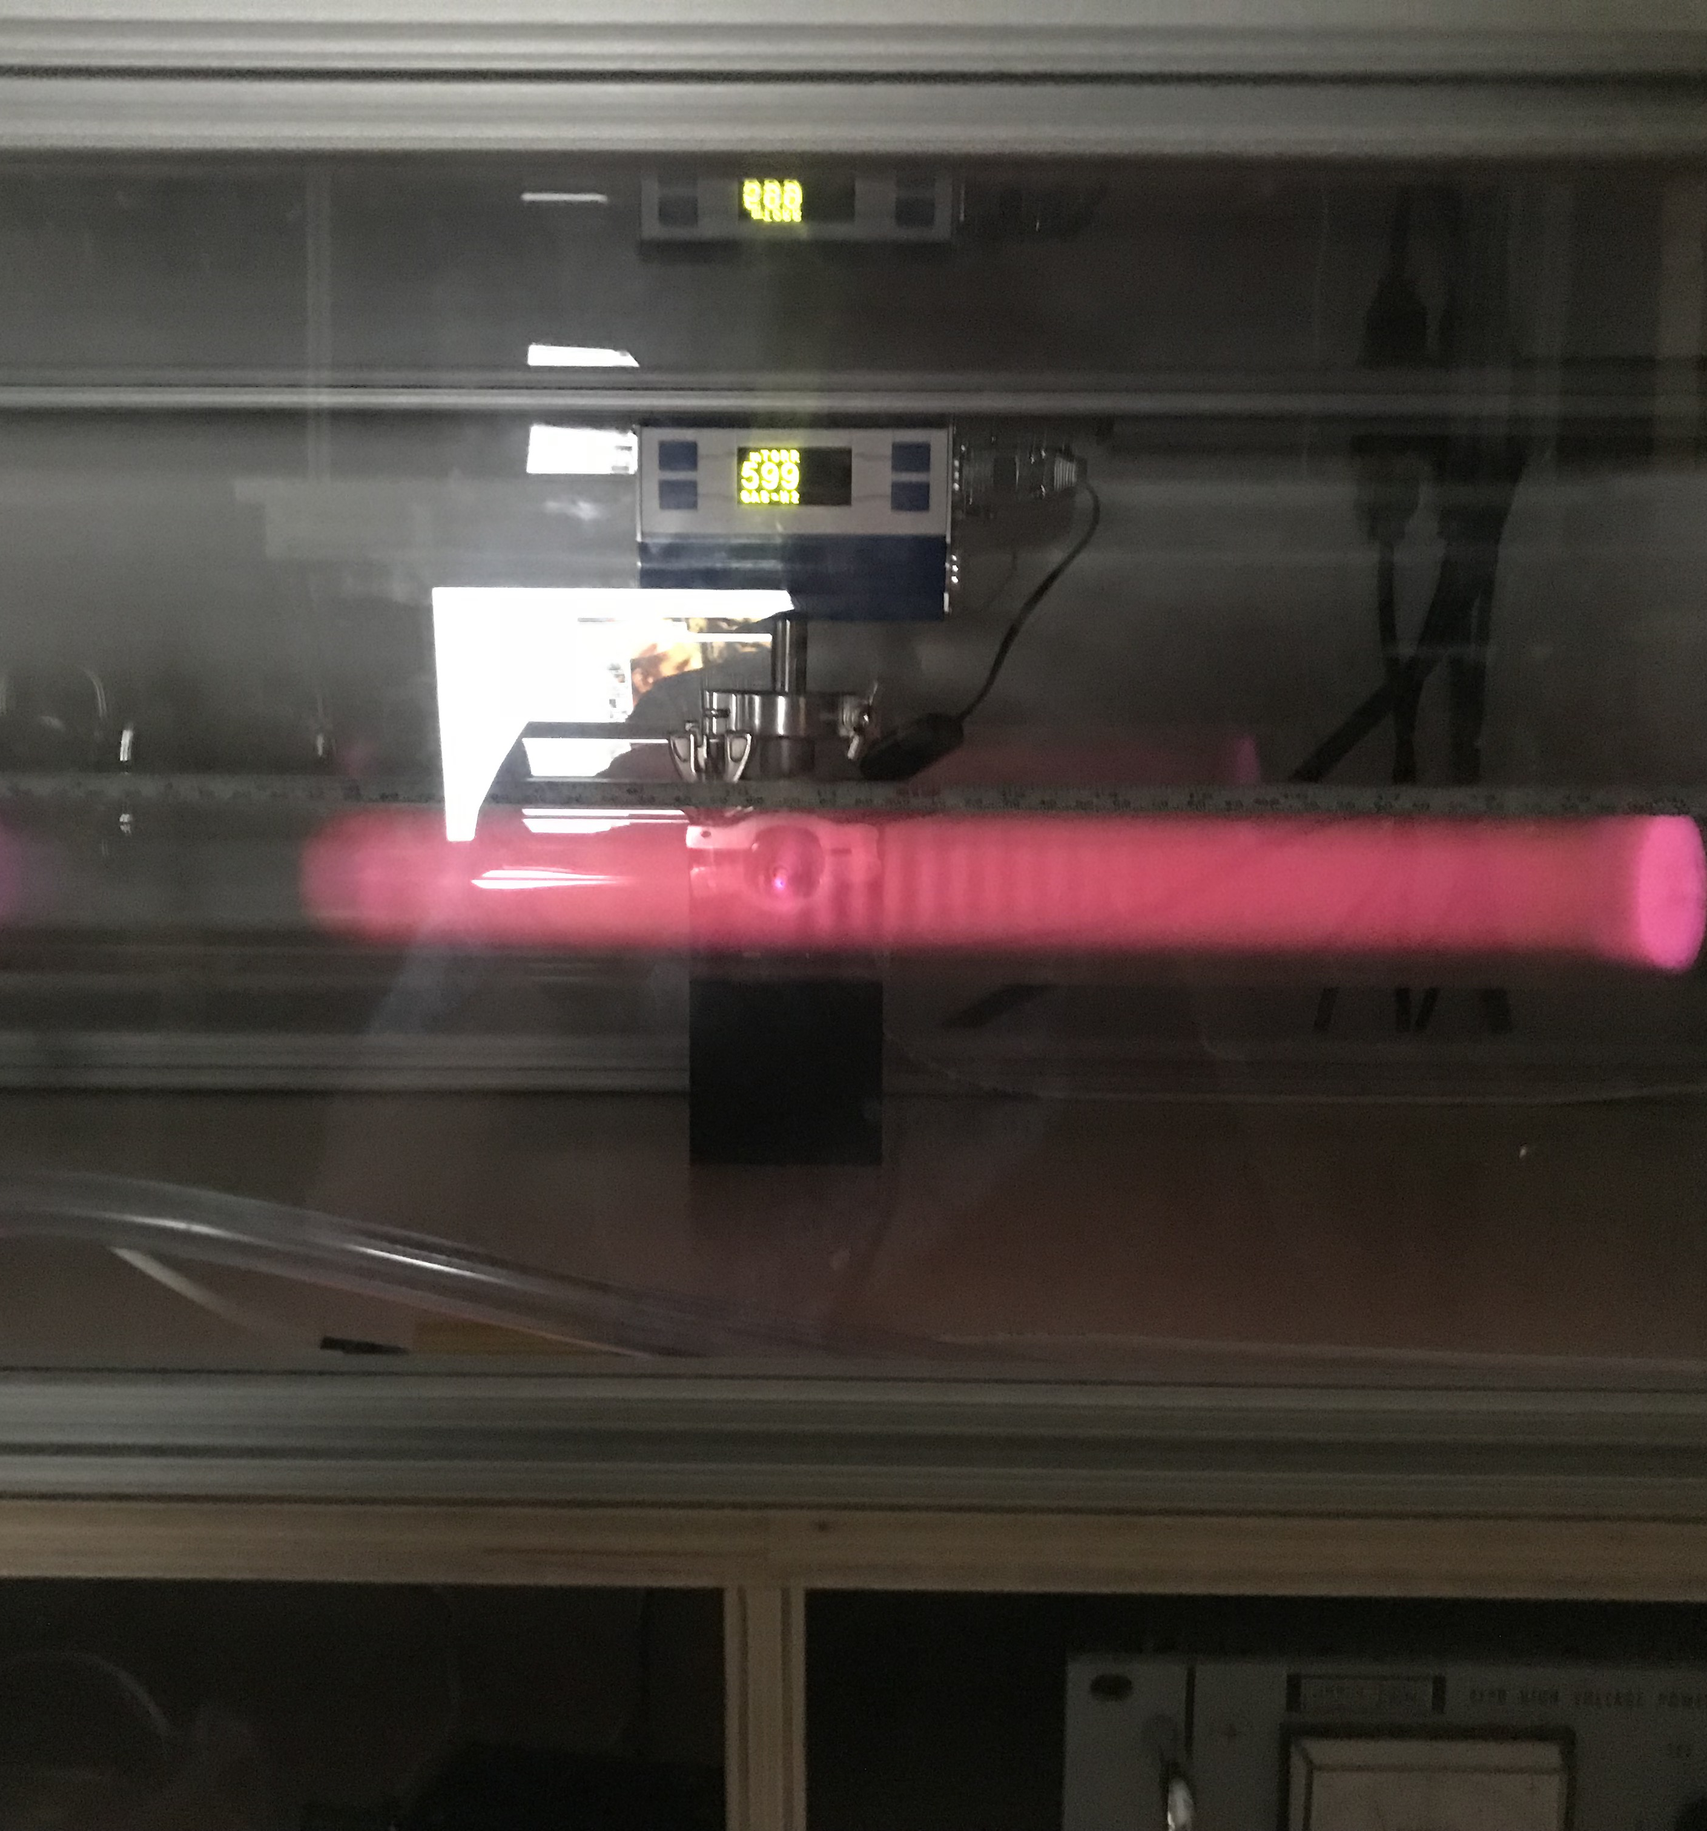
Langmuir Probe
Experimental Collaboration From University of Colorado Denver
Kathryn Harris and Idriss Kacou
Associate Professor: Randall Tagg

Slide 2

Outline
Introduction
Core Idea
Plasma Electron Temperature
Plasmas: Ions and Electrons
Equipment for this Experiment.
The Langmuir Probe
Keithley Integration/Python Setup
Origin
Library
Function
Data Analysis
~1400V at varying pressures
592mTorr at varying base voltages
Summary

Slide 3

Introduction
The interpretation of the current-voltage (I-V)
The most widespread use of Langmuir probes at present is in the semiconductor industry, where radiofrequency (rf) sources are used to produce plasmas for etching and deposition.
These partially ionized plasmas require special techniques in probe construction and theory. Emphasis will be given to this new forefront of diagnostics research.

Slide 4
Major equipment
Picoammeter with swept potential
Computer-based experiment control and data acquisition programmed using Python
The plasma tube
High-voltage power supply

Slide 5

Core Idea
Plasma Electron Temperature
Plasmas: Ions and Electrons

Slide 6

Temperature
We know that Langmuir probe is a low temperature plasmas.
Plasmas are ionized gases characterized by macroscopic parameters that include temperatures, densities, and pressure
The electron temperature can be much different than the temperatures of ions and neutrals.
Plasmas consist of both ions and electrons acting as a semi-coherent system. Using the common definition of temperature, the ions and electrons should be at the same temperature. However, because the electrons have much smaller mass than the ions, they have greater thermal velocity. This means that their motion due to temperature is greater. Also because of this lower mass, when we introduce a floating potential, the electrons respond more strongly than the ions.
This results in the electrons’ effective temperature being higher than the ions’ effective temperature, even though they are part of the same body of plasma. The electrons’ temperature is dependent on pressure and the gas that has been ionized. We also found an inverse relationship between changes in the base voltage and the temperature.
$$I α e^{\sqrt{v_{x}^{2}+v_{y}^{2}+v_{z}^{2}}/kT}$$
Notes:
Research Problem
Hypothesis
Conduct experiment
Collected data
Analyze data
Form a conclusion
Repeat the work.

Slide 7
Ions & Electrons
Plasmas contain mobile electric charges of both signs – that is, both ions and electrons – making them quasi-neutral. Because of this dichotomous nature, the plasma responds to external charges as if it is also charged.
1
Experiments of plasmas have an important role in our modern days because it helps us understand the theory behind them which helps us replicate experiments in a laboratory setting. With modern technology, we can go one step up by computing the data we collect in the experiment for further study.
3
The ions and electrons behave slightly differently because they have different charges and masses. The thermal energy has an important role in the body’s surface and is tied to the electrical potential.
2

Slide 8

Experimental Setup

Slide 9
The Langmuir Probe
The Langmuir probe introduces a bias potential to the plasma while measuring the current that runs through it.
Floating potential is not plasma potential
Compares potential on the tube to potential inside
We may determine a variety of things, including electron and ion temperatures.

Slide 10
Keithley Integration/Python Setup
Python
Origin
Created in 1991
Library used in our Experiment.
Pandas
Matplotlib.pyplot
Math
Keithley
Function
high-performance, easy-to-use data structures and data analysis tools

Slide 11
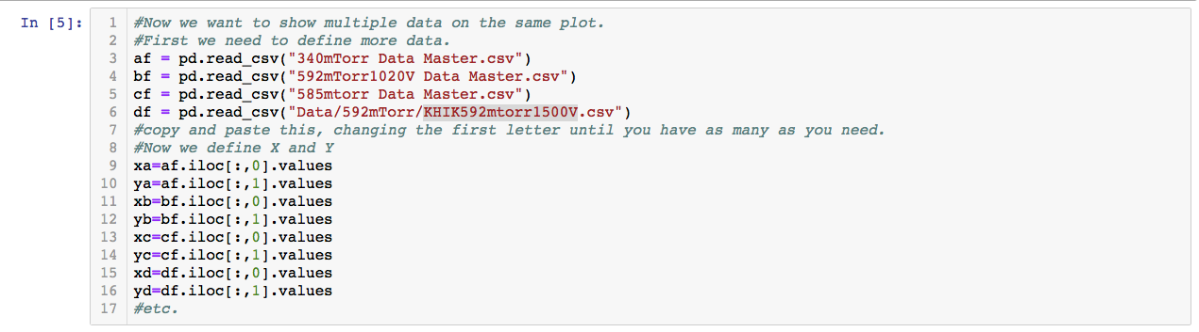
Data Analysis

Slide 12
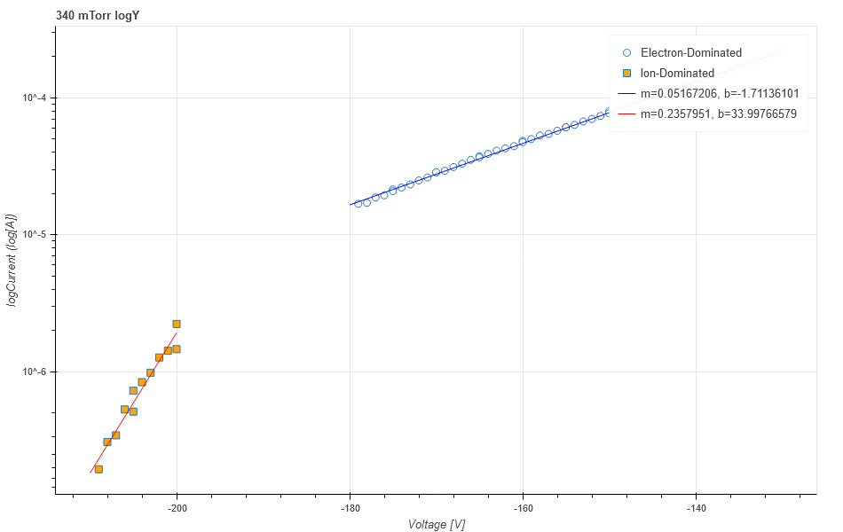
340mTorr LogY

Slide 13
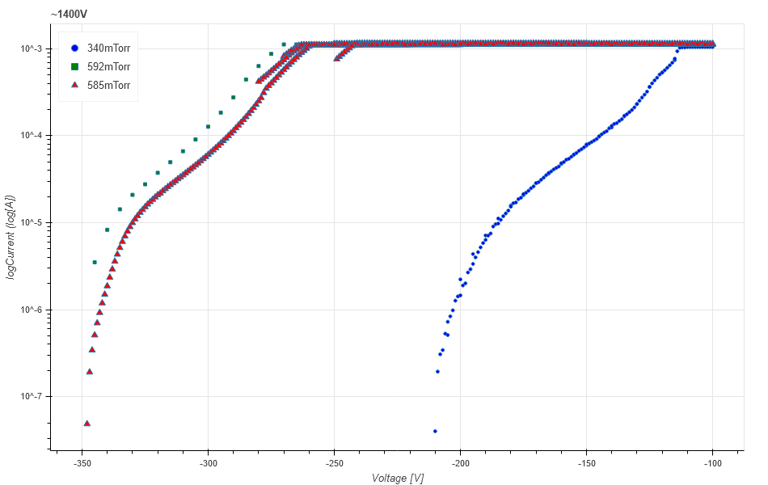
Here we have multiple datasets of different pressures near the same voltage. We see that lower (greater magnitude) voltages are required as our pressure increases. We also, as we would expect, notice steeper slopes for higher pressures, indicating lesser temperatures.

Slide 14
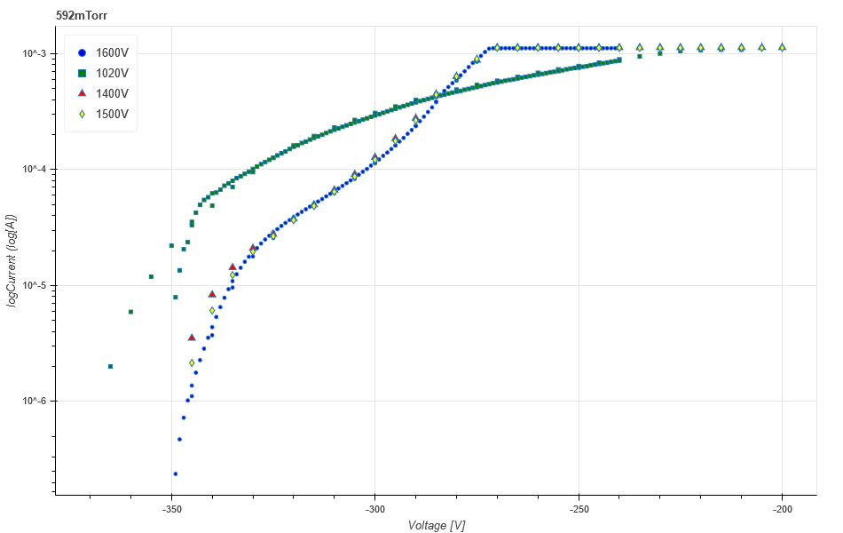
Here we have multiple datasets of different voltages near the same pressure. We see that greater magnitude base voltages are have more pronounced ion-dominated and electron-dominated regions. We also notice that it takes a significant change in base voltage to see a clear change. Higher voltage was associated with lesser temperatures.

Slide 15
Dataset | Expected Temperature (K) | Calculated Temperature (K)
592mTorr (1600V) | 15134 | 206376
592mTorr (1500V) | 15134 | 166612
592mTorr (1400V) | 15134 | 166612
592mTorr (1020V) | 15134 | 377997
585mTorr (1400V) | 15166 | 202664
340mTorr (1400V) | 16771 | 224459
Expected Temperature is calculated for a given pressure and gas (N² , the closest simple analog for air) is independent of base voltage, using the prelab’s formulae:
cpRterm = 16.27+2*math.log(c*p*R)
Where c and R are constant for the gas and p is our pressure,
etempRatioGuess = cpRterm
fvalue = etempRatio-0.5*math.log(etempRatio)-cpRterm
etempRatio=opt.fsolve(etempfunc,etempRatioGuess,args=(cpRterm))
etemp=Vi/etempRatio
And calculated temperature is measured as
m = e/kT
T = e/mk

Slide 16
Summary
The Langmuir probe is a pressurized tube which runs a sweeping potential through a plasma. We controlled this sweeping potential and recorded current over the sweeping potential using code written in python.
Python was used for data analysis as well. By comparing slopes for electron-dominated currents under various pressures at similar base voltages, we found that our temperature — as we would expect — increased with pressure.
By comparing slopes for electron-dominated currents at various base voltages at the same pressure, we found that the shape of the current function was much more pronounced at higher magnitude base voltages, and that because of the more curved shape, temperature dropped as base voltage increased.

Slide 17
Modeling the Langmuir Probe Current-Voltage (I-V) Characteristic: Merlino, R. L., "Understanding Langmuir probe current-voltage characteristics", Am. J. Phys. 75, 1078-1087 (2007).
How Langmuir Probes Work: Merlino, Robert L. Understanding Langmuir Probe Current-Voltage Characteristics. 14 July 2007.

